Slide 1
UNIT-1
TOPIC- INTERNATIONAL MARKETING
(M.Com. (Final year)
PRESENTED BY
Poonam
Assistant Professor
Kanya Mahavidyalaya, Kharkhoda

Slide 2
Agenda
The international marketing concept
A brief introduction of international marketing environment
Major obstacles in international marketing
Stages of international marketing involvement

Slide 3

International Marketing
It refers to marketing carried out by companies overseas or across national borderlines.
The performance of the business activities that direct the flow of a company’s goods and services to consumers or users in more than one nation for a profit.

Slide 4
American Marketing Association (AMA)
The multinational process of
▫ planning and executing the conception,
▫ pricing, promotion and distribution of ideas,
▫ goods, and services to create exchanges that satisfy individual and organizational objectives

Slide 5
INTERNATIONAL MARKETING
In simple words International Marketing is the application of marketing principles to across national boundaries.
However, there is a crossover between what is commonly expressed as international marketing and global marketing, which is a similar term.

Slide 6
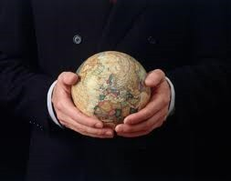
Global marketing
It refers to marketing activities integrated across multiple country markets.

Slide 7

International Marketing Vs. Domestic Marketing
The main difference between them is that the marketing activities take place in more than one country.
more complicated, at least two levels of uncontrollable uncertainty instead of one.

Slide 8
International Marketing Vs. Domestic Marketing
Competition, legal restraints, government controls, weather, fickle consumers, and any number of other uncontrollable elements can, and frequently do, affect the profitable outcome of good, sound marketing plans.

Slide 9

International Marketing Vs. Domestic Marketing
Marketer can not control or influence these uncontrollable elements, but instead must adjust or adapt to them in a manner consistent with a successful outcome.

Slide 10
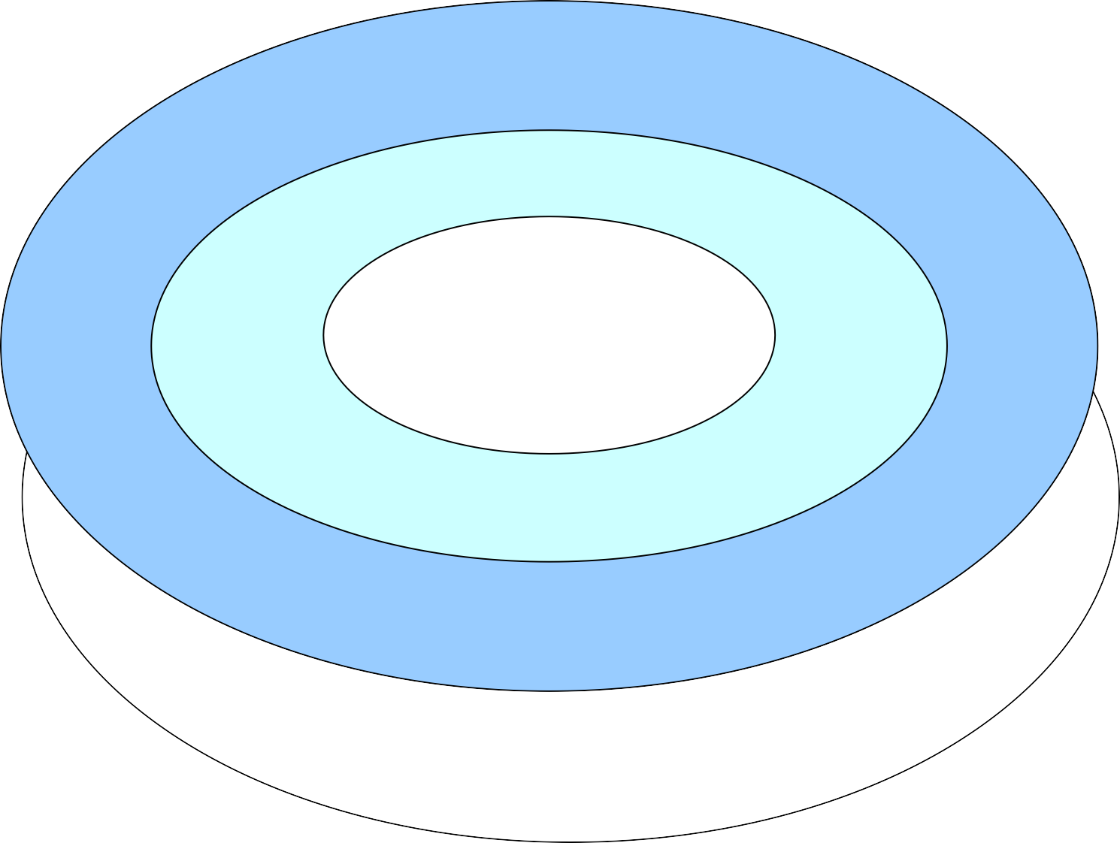
International Marketing Environment
Source: Philip R. Cateora. International Marketing. Ninth edition
Foreign environment
(uncontrollable)
Political/legal forces
Economic forces
Domestic environment (uncontrollable)
Political
/ legal forces
(controllables)
Competitive
Competitive
Cultural forces
structure
forces
Economic climate
Geography and infrastructure
Level of technology
Structure of distribution
Environmental uncontrollables country market A

Slide 11
International environmental forces
Marketing controllables: The successful manager constructs a marketing program designed for optimal adjustment to the uncertainty of the business climate.
Domestic uncontrollables: This includes home- country elements that can have a direct effect on the success of a foreign venture: political forces, legal structure, and economic climate.
Foreign uncontrollable: The problem of uncertainty is further complicated by a frequently imposed “alien status” that increases the difficulty of properly assessing and forecasting the dynamic international business climate.

Slide 12


International environmental forces
Thus a strategy successful in one country can be rendered ineffective in another by differences in political climate, staged of economic development, level of technology, or other cultural variation.

Slide 13
International marketing-Barriers
International marketing is often not as simple as marketing your product to more than one nation. Companies must consider
▫ language barriers,
▫ ideals, and
▫ customs in the market they are approaching.

Slide 14
Stages Of International Marketing Involvement
▫
No Direct Foreign Marketing: trading companies, foreign customers, domestic wholesalers, distributors
Infrequent Foreign Marketing: Temporary surpluses caused by variations in production levels or demand, few companies today fit this model Regular Foreign Marketing: foreign or domestic overseas intermediaries, own sales force or sales subsidiaries
▫
▫

Slide 15
Stages Of International Marketing Involvement
International Marketing: fully committed and involved in international marketing activities. Such companies seek markets all over the world and sell products that are a result of planned production for markets in various countries.
Global Marketing: Market segmentation decisions are no longer focused on national borders. Instead, market segments are defined by income levels, usage patterns, or other factors.
▫
▫

Slide 16
THANK YOU

